Slide 1



Slide 2
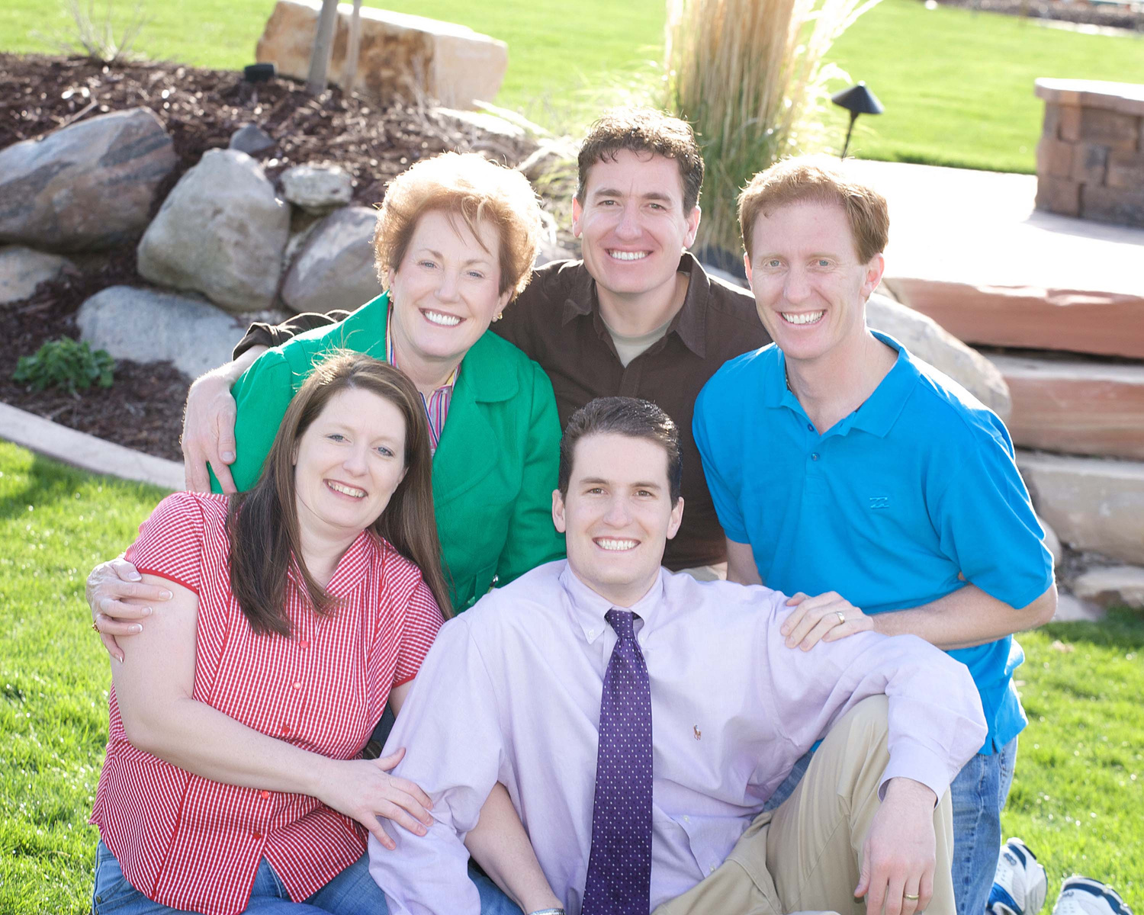
Title
Text text text text text text text text. Text text text text text text text text. Text text text text.
Notes:
What’s even more powerful about this story is how it’s come full circle.
Those two little boys who were once told they’d never have real jobs Justin and Jeremy now help lead this incredible company, right alongside their siblings Jennifer and Jeff.
They didn’t just overcome a label they redefined it.
Today, they’re running a company that’s changing lives for thousands of students, helping other children hear their teachers clearly, connect with their classmates, and reach their full potential just like their mom once dreamed for them.
Audio Enhancement isn’t just a business; it’s a family mission that turned into a movement proof that when you believe in every child’s ability to learn, you can change the world one classroom at a time.

